Slide 1
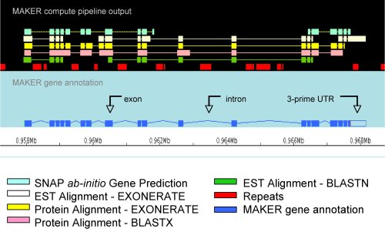
Maker-annotation tool
MAKER is a portable and easy to configure genome annotation pipeline.
What does MAKER do?
Identifies and masks out repeat elements
Aligns ESTs to the genome
Aligns proteins to the genome
Produces ab initio gene predictions
Synthesizes these data into final annotations
Produces evidence-based quality values for downstream annotation management

Slide 2
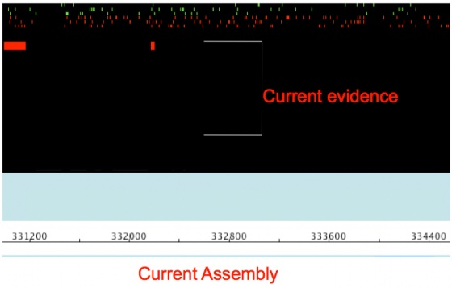
What is Going on Inside of MAKER
-> Repeat Masking
MAKER identifies repeats in two steps
First MAKER runs a program called RepeatMasker is used to identify both all classes of repeats that match entries in the RepBase repeat library
Next MAKER uses RepeatRunner to identify transposable elements and viral proteins using the RepeatRunner protein database
Regions identified during repeat analysis are masked out in two different ways:
Complex repeats are hard-masked
Simple repeats are soft-masked

Slide 3
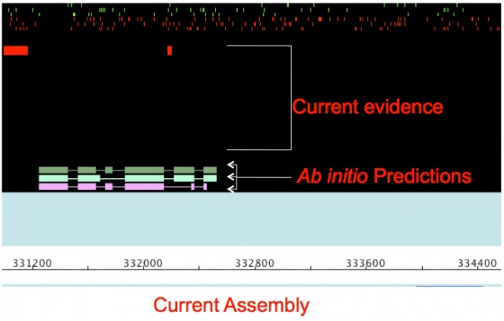
-> Ab Initio Gene Prediction
Ab initio gene predictors produce gene predictions based on underlying mathematical models describing patterns of intron/exon structure and consensus start signals
MAKER currently supports:
SNAP (Works good, easy to train, not as good as others especially on longer intron genomes).
Augustus (Works great, hard to train, but getting better)
GeneMark (Self training, no hints, buggy, not good for fragmented genomes or long introns).
FGENESH (Works great, costs money even for training)

Slide 4
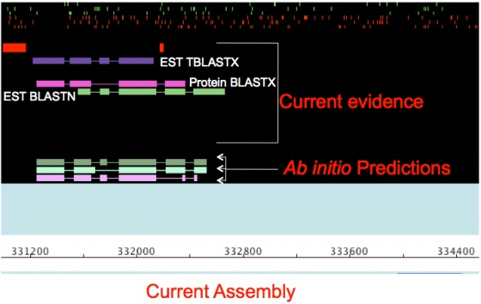
-> RNA and Protein Evidence Alignment
To indicate if a sequence region is likely associated with a gene is to identify
if the region is actively being transcribed
if the region has homology to a known protein
This can be done by aligning Expressed Sequence Tags (ESTs) and proteins to the genome using alignment algorithms.

Slide 5
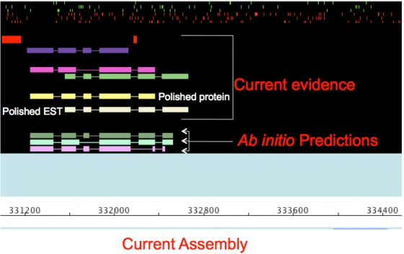
-> Polishing Evidence Alignments
To get more informative alignments MAKER uses the program Exonerate to polish BLAST hits

Slide 6
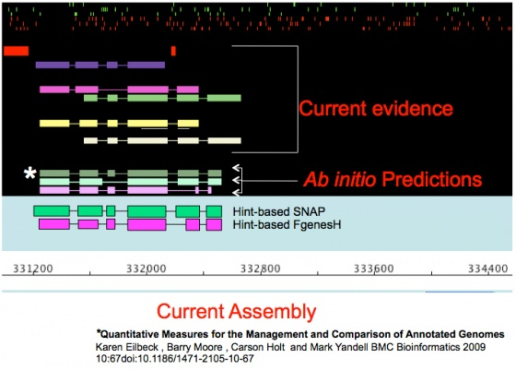
-> Selecting and Revising the Final Gene Model
MAKER chooses from among all the gene model possibilities the one that best matches the evidence.
This is done using a modified sensitivity/specificity distance metric

Slide 7
Maker test run
Maker run on O.barthii_chr1_short_arm and O.barthii whole genome sequence
Maker benchmarks for O.barthii_chr1_short_arm
Server : Redhat (bam)
Peak Memory usage : 100-120Gb out of 256Gb RAM
Input file size: < 1GB
Output file size : 3.2G
No of CPU's/cores: 10 out 24
Run time: 5 days
Maker benchmarks for O.barthii whole genome sequence
Server : Redhat (bam)
Peak Memory usage : 100-120Gb out of 256Gb RAM
Input file size: < 1GB
Output file size : 21G
No of CPU's/cores: 10 out 24
Run time: 3.5 weeks

Slide 8
THANK YOU ☺

